Slide 1
FAKE REVIEW DETECTION USING DEEP LEARNING
Guided by
Ms.K.S.JAYAKERA
ASSISTANT PROFESSOR
Department of CSE/SCT
Done by
DEEPADHARSAN M
DHANUSH V
DHANUSHWAR B
Final year CSE A /SCT

Slide 2
OBJECTIVE
Enhance fake review detection systems with advanced strategies like LSTM and NLP techniques.
Sophisticated NLP techniques integrated into advanced deep learning architectures reconstruct sentences with enhanced accuracy and contextual understanding.
Foster collaboration across academia, industry, and regulation to combat fraudulent reviews effectively.

Slide 3
PROBLEM STATEMENT
The surge in online shopping, particularly during the pandemic, has led to a proliferation of fake reviews on platforms like Flipkart and Amazon. This inundation makes it difficult for consumers to discern between genuine and fraudulent feedback, undermining their trust in online reviews.
The pressing need arises for effective methods to sift through this deluge of reviews and identify deceptive ones. Leveraging sophisticated technologies such as Deep Learning and Machine Learning, there's an opportunity to develop algorithms capable of accurately detecting and filtering out fake reviews, ensuring a more reliable online shopping experience for consumers.

Slide 4
LITERATURE SURVEY
S.NO | TITLE | AUTHOR & YEAR | DESCRIPTION
1. | Fake reviews detection using supervised machine learning. | Elmogy, A.M., Tariq, U., Ammar, M. and Ibrahim, A., 2021. | Paper proposes ML approach for fake review detection, using review features and reviewer behaviors. Experiments on Yelp dataset show KNN achieves highest f-score (82.40%), with 3.80% improvement from baseline when considering behavioral features.
2. | Enhancing NLP techniques for fake review detection | Kashti, M.R.P. and Prasad, P.S., 2019 | The paper evaluates the effectiveness of fake review detection techniques using an Amazon dataset, emphasizing the importance of combatting deceptive practices and preserving the integrity of online reviews.

Slide 5
3. | Data analytics for the identification of fake reviews using supervised learning | Alsubari, S.N., Deshmukh, S.N., Alqarni, A.A., Alsharif, N., Aldhyani, T.H., Alsaade, F.W. and Khalaf, O.I., 2022 | Supervised machine learning techniques including Naïve Bayes, SVM, adaptive boosting, and random forest achieve high accuracy in detecting fake reviews on a Trip Advisor dataset.
4. | Twitter spam detection based on deep learning. | Wu, T., Liu, S., Zhang, J. and Xiang, Y., 2017, January. | Novel deep learning technique learns tweet syntax with WordVector Training Mode to construct a binary classifier. Experimental validation on real Tweet datasets shows superiority over existing text-based and non-text-based detection techniques.
5. | Multiple features based approach for automatic fake news detection on social networks using deep learning. | Sahoo, S.R. and Gupta, B.B., 2021 | Develop automatic fake news detection in Chrome, utilizing Facebook account and news content features via deep learning. Experimental validation demonstrates superior accuracy compared to existing techniques.

Slide 6
RESEARCH GAPS
Low accuracy: This indicates that the model's performance in correctly identifying fake reviews may not be satisfactory. Improving accuracy is crucial for reliable detection of fake reviews.
Need to increase overall performance: Beyond just accuracy, there may be other performance metrics that need enhancement, such as precision, recall, or F1 score. Enhancing overall performance ensures that the model effectively distinguishes between genuine and fake reviews across various scenarios.

Slide 7
PROPOSED SYSTEM
Utilizes deep learning (DL) methods such as LSTM for review analysis.
Implements preprocessing techniques to extract pertinent features from reviews.
Utilizes collaborative filtering to scrutinize reviewer behavior for anomalies.
Integrates advanced technologies including DL, NLP and collaborative filtering.
Aims to combat fake reviews and enhance consumer trust in E-commerce platforms through comprehensive analysis and detection techniques.

Slide 8
APPLICATIONS OF NLP
NLP recognizes patterns like excessive positivity or repetitive phrases in reviews, aiding in flagging suspicious content.
Sentiment analysis detects anomalies in review sentiments, identifying fake reviews with either overly positive or negative sentiments.
NLP contextualizes reviews, detecting inconsistencies like sudden spikes or demographic mismatches, indicative of fraudulent activity.

Slide 9
APPLICATIONS OF LSTM
LSTM is a recurrent neural network architecture designed to address the vanishing gradient problem and effectively capture long-term dependencies in sequential data.
Its memory cells contain three gates—forget, input, and output—that control the flow of information, enabling the network to selectively remember or discard information as needed.
LSTMs excel in tasks like natural language processing, time series prediction, and speech recognition by learning and retaining patterns over extended sequences, thus facilitating accurate predictions in various domains.

Slide 10
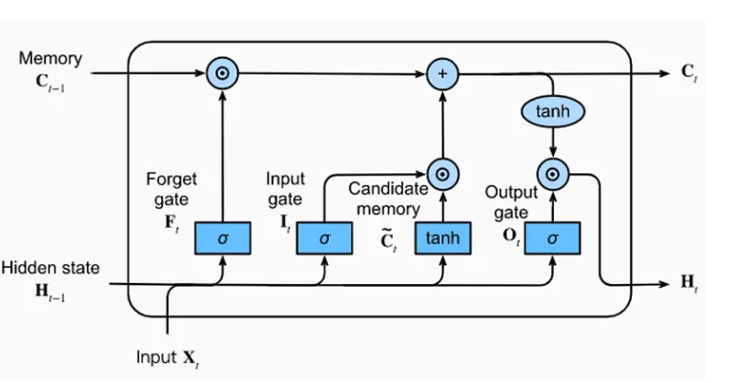
WORK FLOW OF LSTM

Slide 11
RESULT & DISCUSSIONS
Our LSTM-trained model achieves a high accuracy rate of 93% in identifying fake reviews, demonstrating its effectiveness in distinguishing between genuine and fraudulent content.
Leveraging its ability to capture long-term dependencies in sequential data, the model excels in analyzing textual information such as online reviews.
This superior performance bolsters confidence in the system's ability to detect deceptive practices and protect consumers from misinformation.
The robustness of our LSTM model underscores its value in maintaining the integrity of online review systems.

Slide 12
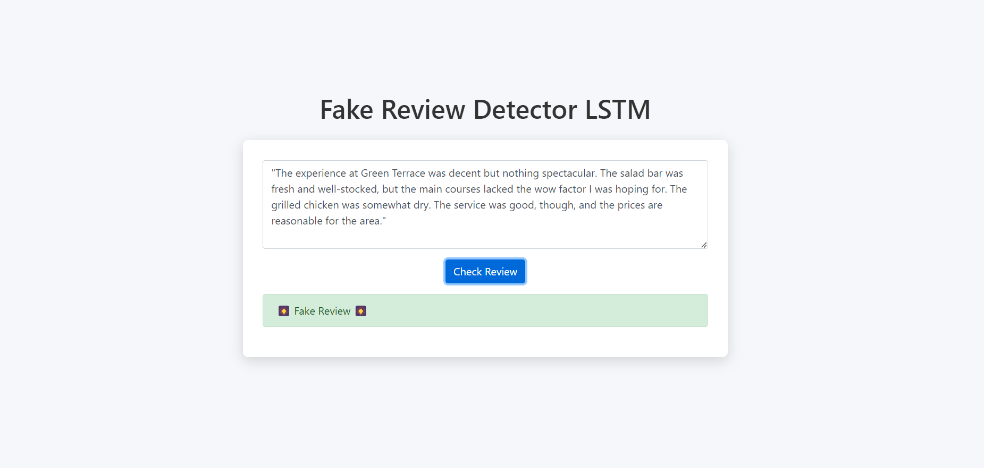
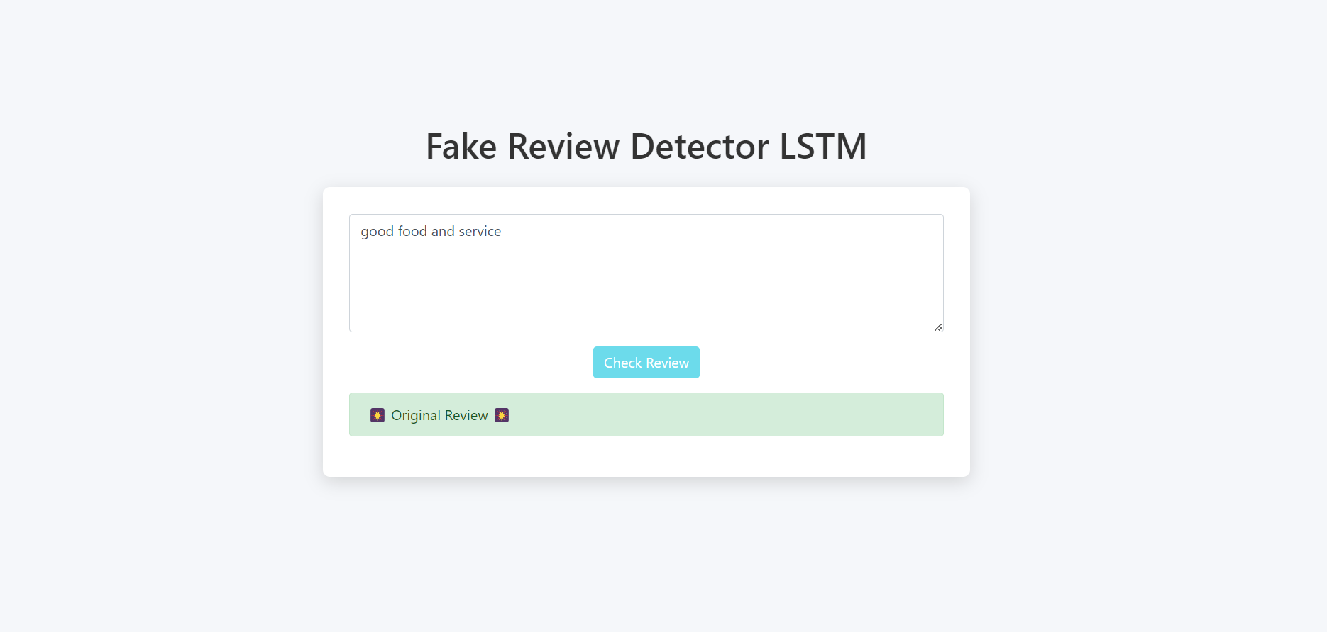

Slide 13
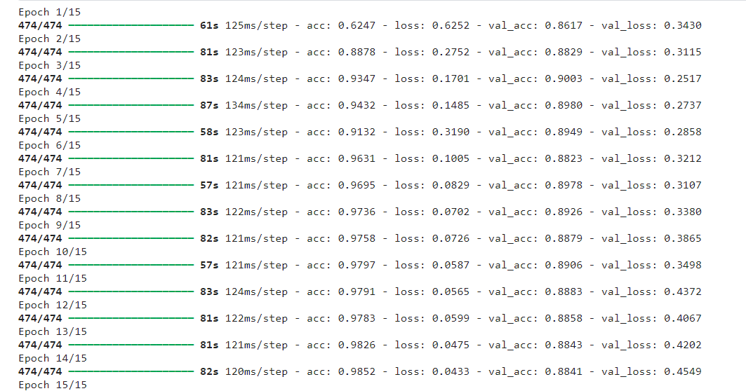

Slide 14
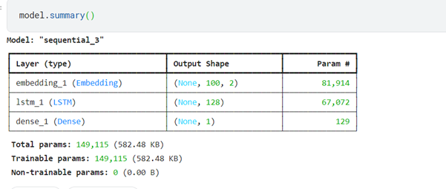
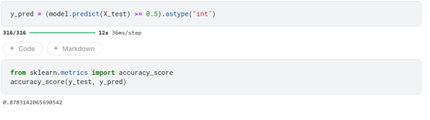

Slide 15
CONCLUSION AND FUTURE WORKS
Developed a fake review detection system for online platforms, aiding users in discerning the authenticity of product reviews, thus fostering trust in the products' legitimacy.
Implemented algorithms and processes to accurately identify fake reviews, empowering users to make informed decisions about product purchases based on reliable feedback.
Aim to enhance the accuracy of the system beyond its current 93% rate through ongoing research and development efforts.
Employing advanced techniques and methodologies to refine the detection algorithms and improve the system's ability to differentiate between genuine and fake reviews, enhancing user confidence in product evaluations.

Slide 16
REFERENCES
Elmogy, A.M., Tariq, U., Ammar, M. and Ibrahim, A., 2021. Fake reviews detection using supervised machine learning. International Journal of Advanced Comp4uter Science and Applications, 12(1).
Kashti, M.R.P. and Prasad, P.S., 2019. Enhancing NLP techniques for fake review detection. Int. Res. J. Eng. Technol.(IRJET), 6, pp.241-245.
Alsubari, S.N., Deshmukh, S.N., Alqarni, A.A., Alsharif, N., Aldhyani, T.H., Alsaade , F.W. and Khalaf, O.I., 2022. Data analytics for the identification of fake reviews using supervised learning. Computers, Materials & Continua, 70(2), pp.3189-3204.
Sahoo, S.R. and Gupta, B.B., 2021. Multiple features-based approach for automatic fake news detection on social networks using deep learning. Applied Soft Computing, 100, p.106983.

Slide 17
REFERENCES
Vachane, D., 2021. Online Products Fake Reviews Detection System Using Machine Learning. Turkish Journal of Computer and Mathematics Education (TURCOMAT), 12(1S), pp.29-39.
Shinde, M., Shingate, R., Badgujar, T., Zingade, G. and Kadam–Rawte, M.N., FAKE REVIEW DETECTION SYSTEM.
Vachane, D., 2021. Online Products Fake Reviews Detection System Using Machine Learning. Turkish Journal of Computer and Mathematics Education (TURCOMAT), 12(1S), pp.29-39.

Slide 18
THANK YOU

